Slide 1
Relevance of ENTERPRISE INTEGRATION PATTERNS FOR BIG DATA, CLOUD, Iot, microservices
Notes:
1

Slide 2
Outline
Enterprise Integration Patterns Recap
Evolution of Integration
Integration Stack
Big Data / Fast Data Overview and Relevance of EIPs
Cloud Overview and Relevance of EIPs
Internet of Things Overview and Relevance of EIPs
Microservices Overview and Relevance of EIPs

Slide 3
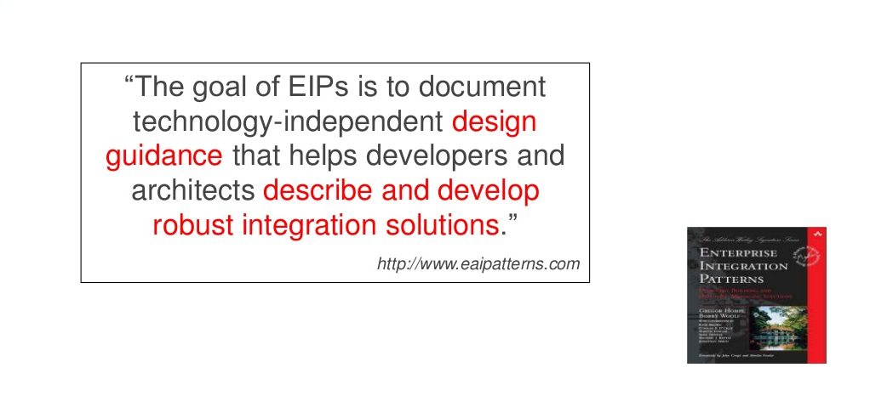
Enterprise Integration Patterns (EIP)

Slide 4
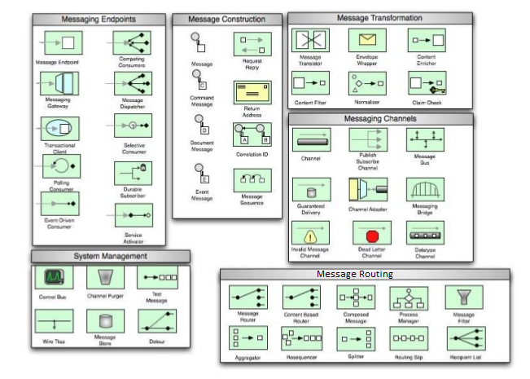
Enterprise Integration Patterns

Slide 5
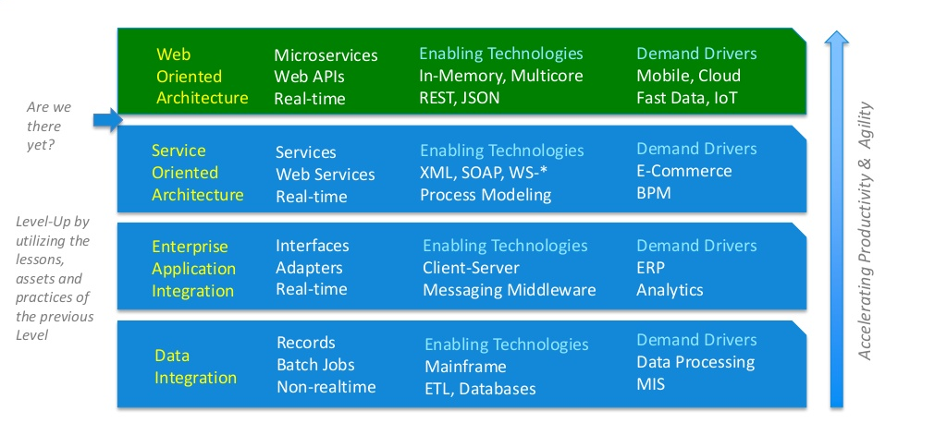
Evolution of Integration

Slide 6
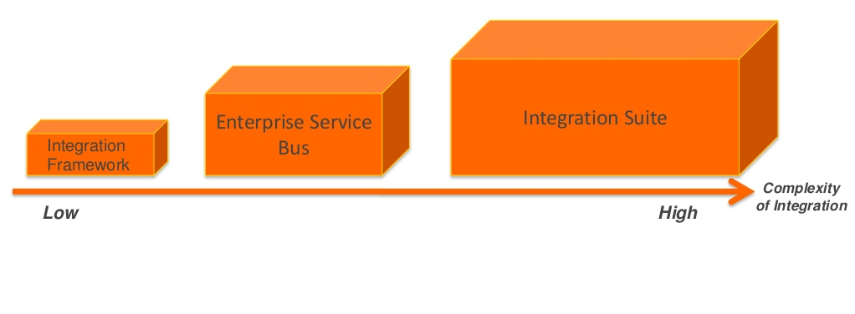
Integration Stack

Slide 7
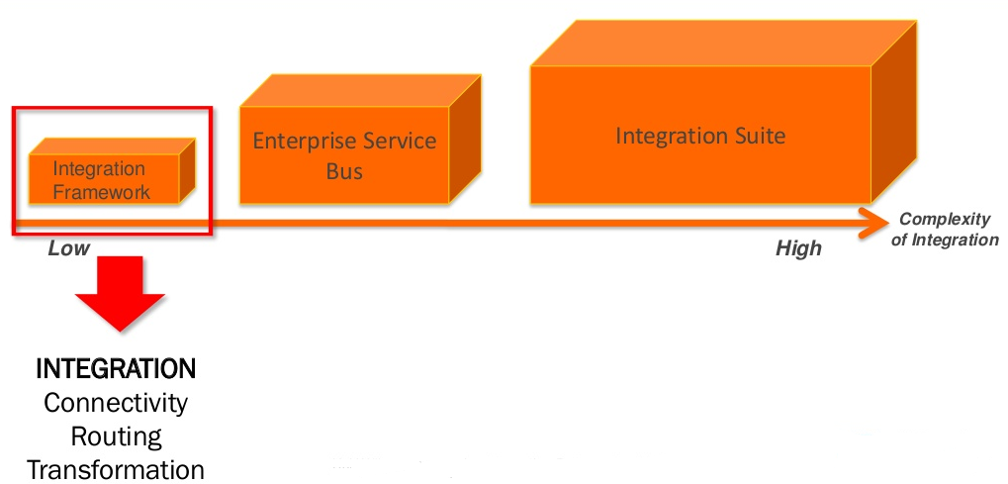
When to go for Integration Framework?

Slide 8
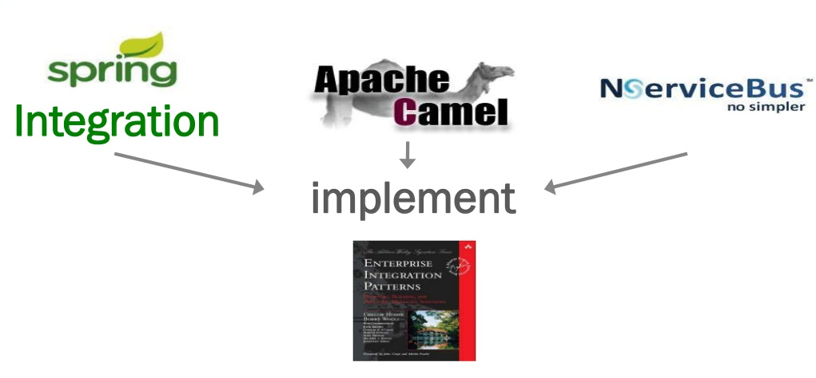
Popular Integration Frameworks

Slide 9
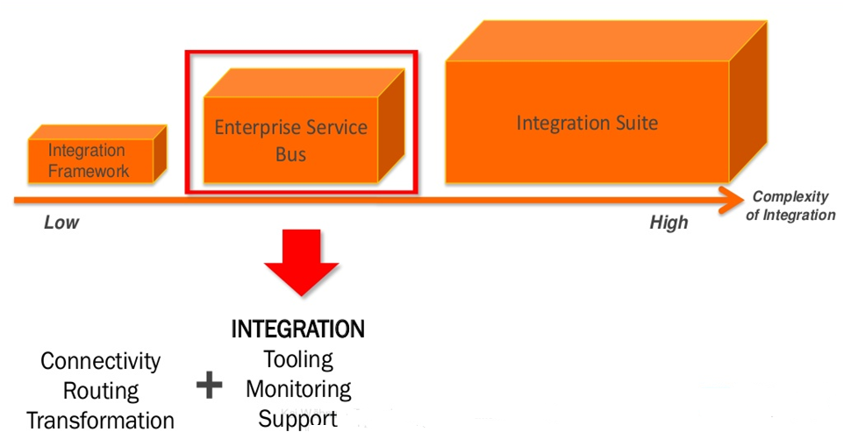
When to go for Enterprise Service Bus?

Slide 10
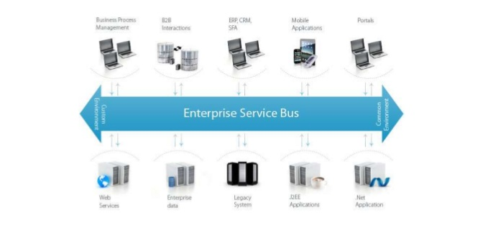
Enterprise Service Bus (ESB)

Slide 11
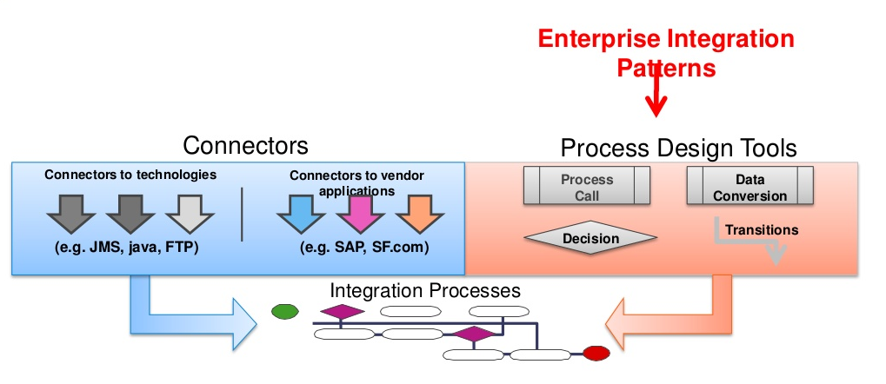
Enterprise Service Bus (ESB)

Slide 12








Popular ESB Vendors

Slide 13
Current challenges and
Future scope of Integration
?

Slide 14
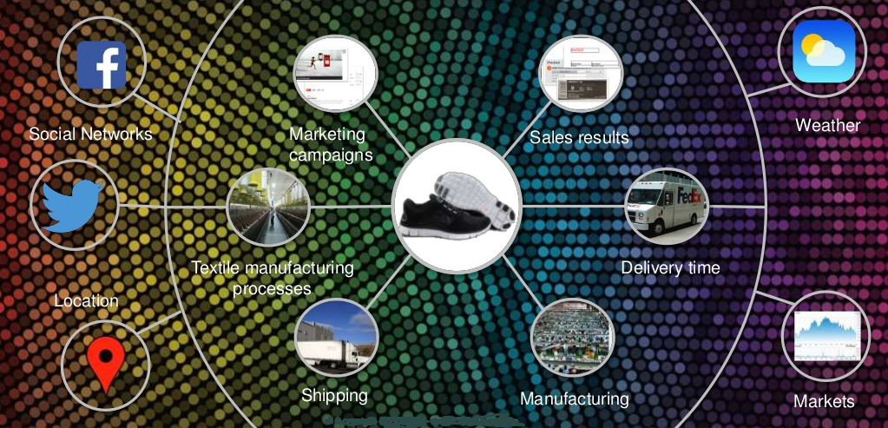
Everything is Connected

Slide 15
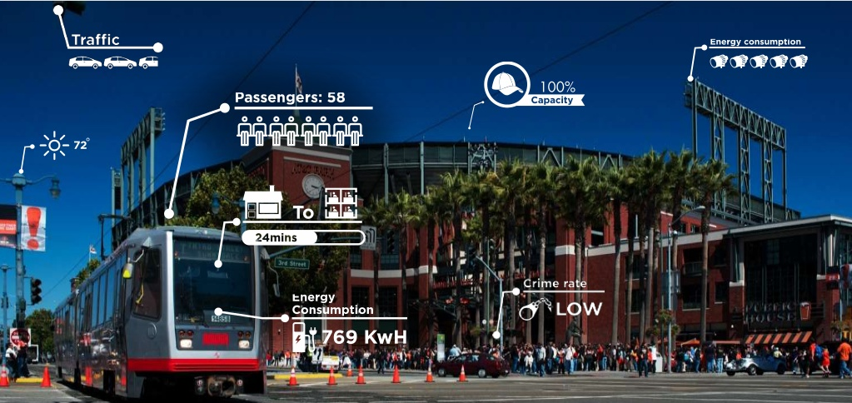
Everything is Generates More Data

Slide 16
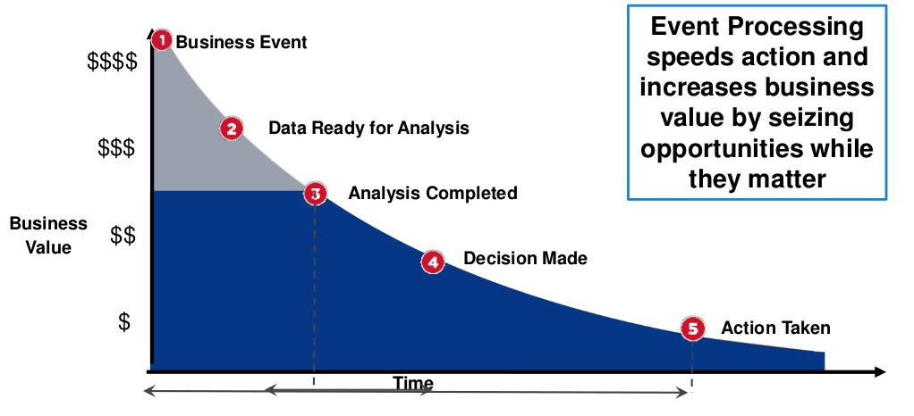
Acting in Real Time is important

Slide 17
Will Integration Frameworks and ESBs enough to meet these growing integration needs?
?

Slide 18
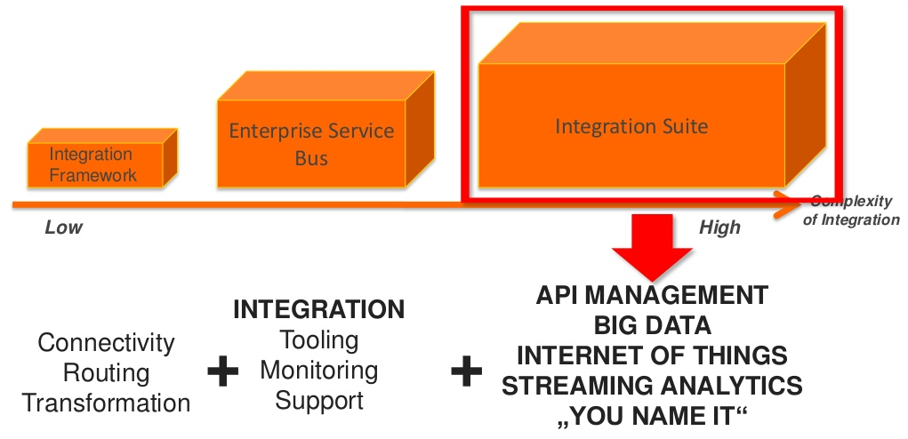
Yes, for some extent with Integration Suites. But, need new breed of integration frameworks, products, suites, etc. Evolving??

Slide 19
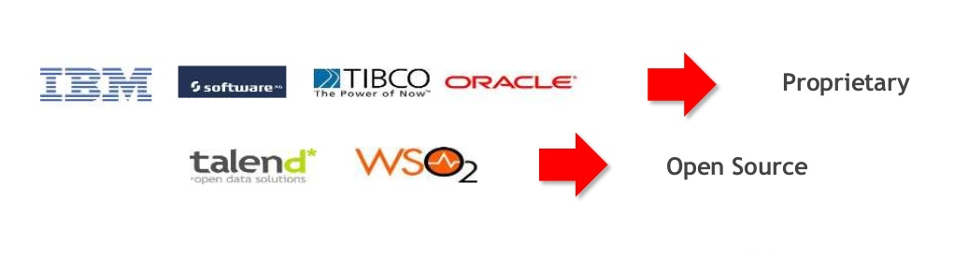
Popular Integration Suite Vendors

Slide 20
Big Data

Slide 21
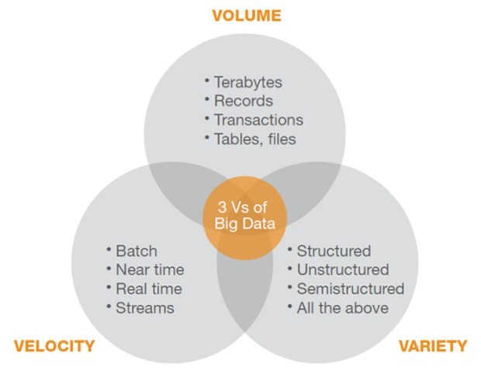
Big Data - Characteristics

Slide 22
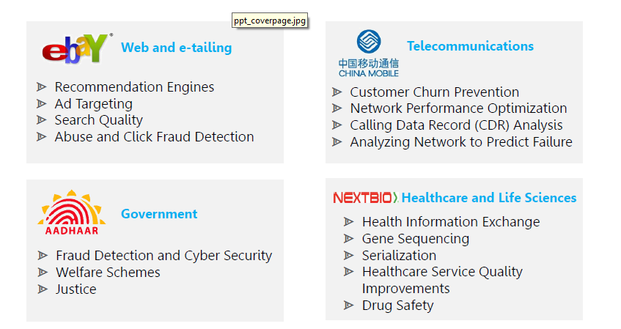
Big Data in Action

Slide 23
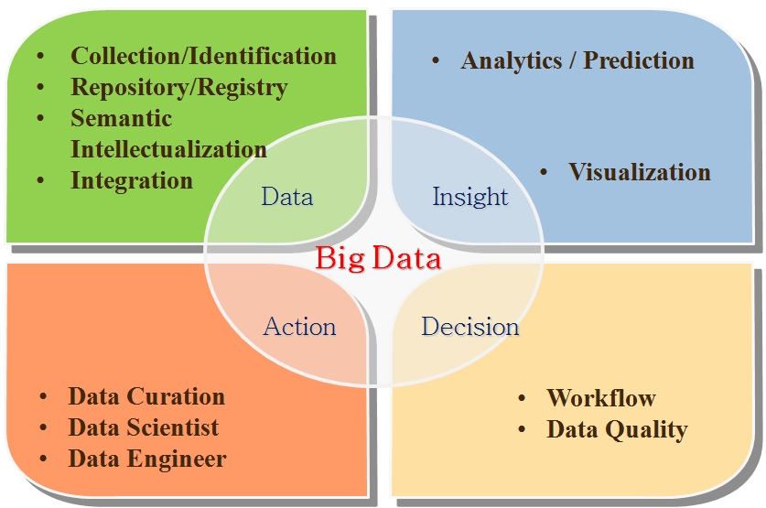
Big Data Lifecycle

Slide 24
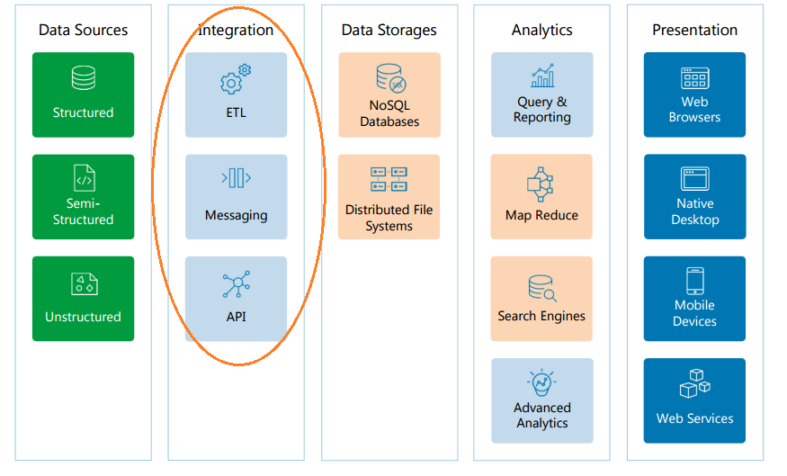
Big Data Reference Architecture

Slide 25
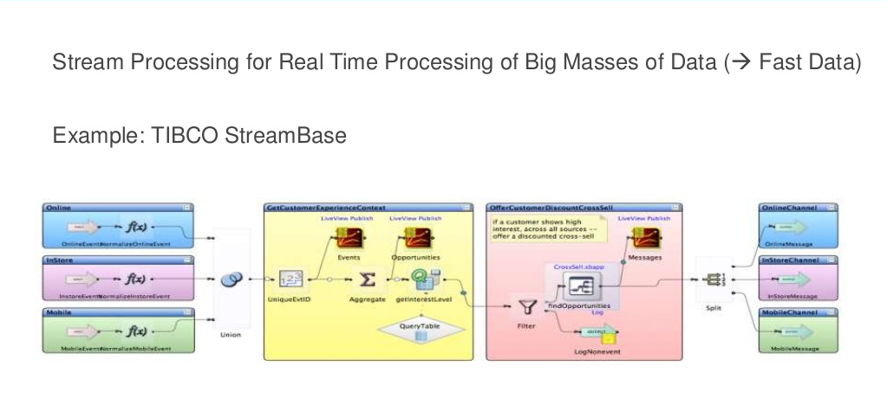
EIPs for Stream Analytics

Slide 26
Big Data Patterns
http://bigdatapatterns.org

Slide 27
Cloud

Slide 28
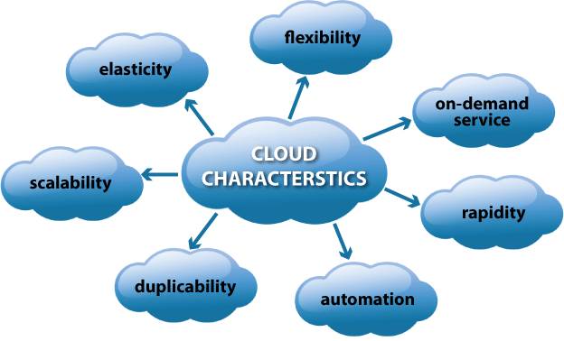
Cloud Computing - Characteristics

Slide 29
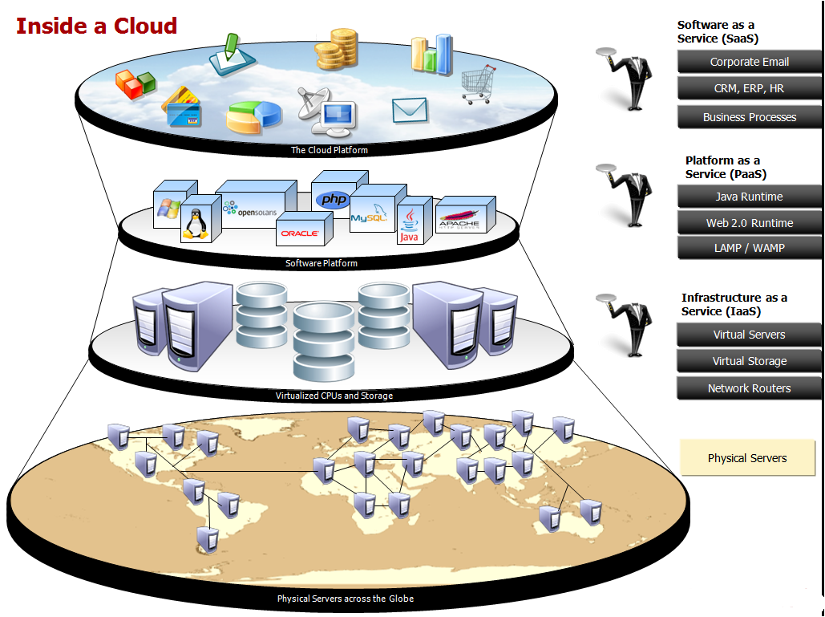

Slide 30
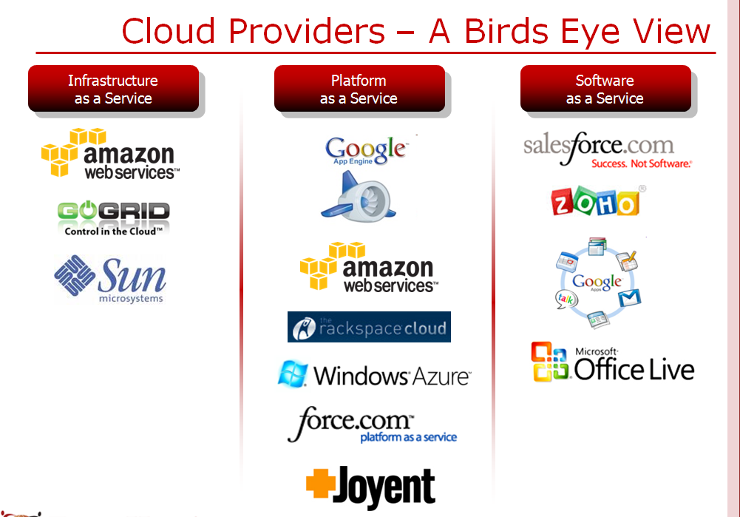

Slide 31
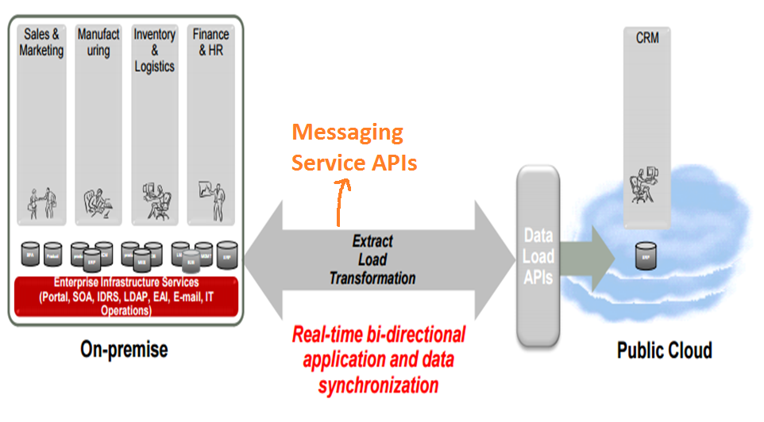
Cloud Integration

Slide 32
Cloud Patterns
http://cloudpatterns.org
http://cloudcomputingpatterns.org

Slide 33
Internet of Things

Slide 34
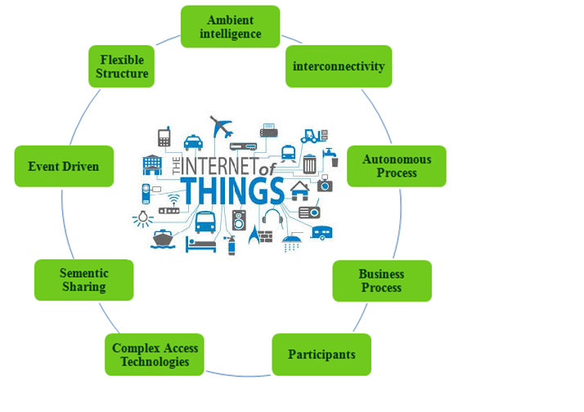
IoT - Characteristics

Slide 35
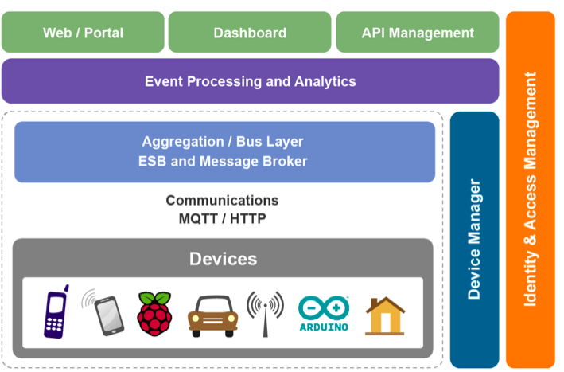
IoT – Reference Architecture

Slide 36
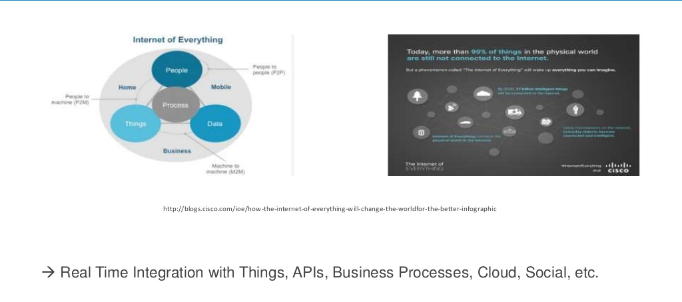
EIPs for integration of “Internet of Everything”

Slide 37
IoT Patterns
http://insights.mindstix.com/design-patterns-for-your-iot-architecture/

Slide 38
Microservices

Slide 39
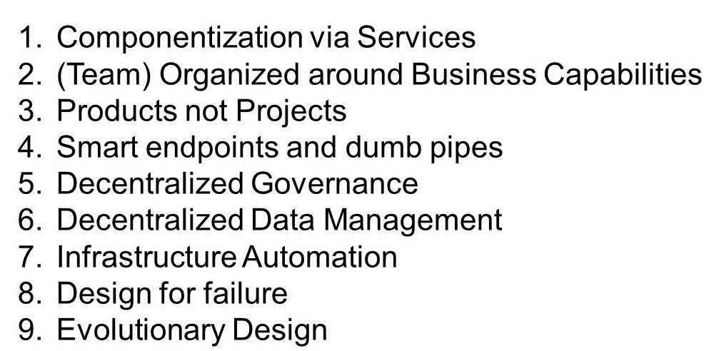
Microservices - Characteristics

Slide 40
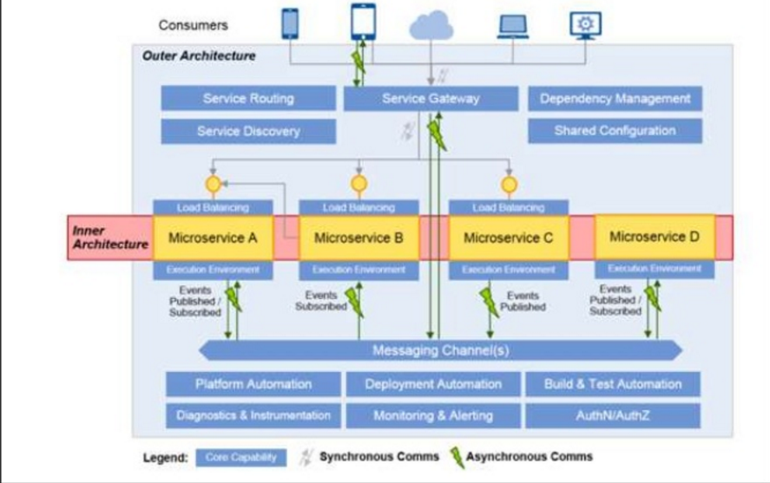
Microservices – Reference Architecture

Slide 41
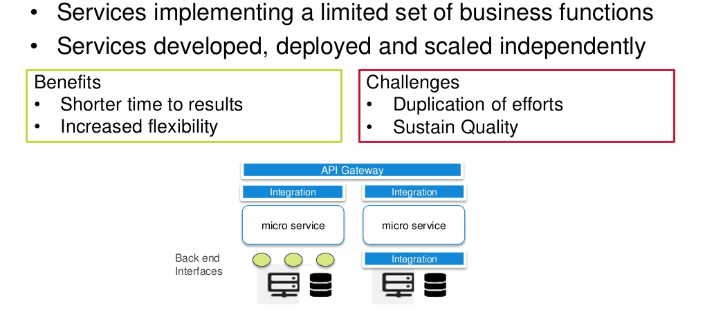
EIPs for Microservices

Slide 42
Microservices Patterns
http://microservices.io/patterns

Slide 43
API Management

Slide 44
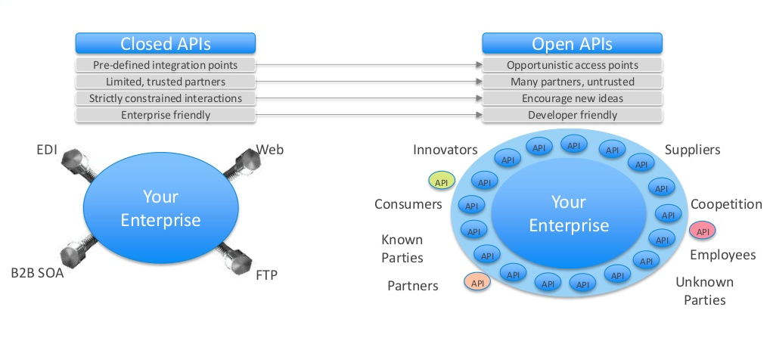
EIPs for Open APIs and API Management

Slide 45
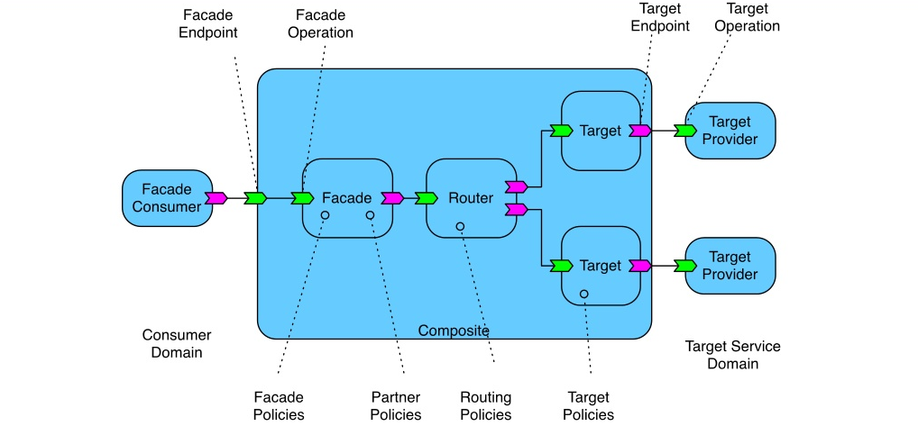
EIPs for API Management

Slide 46
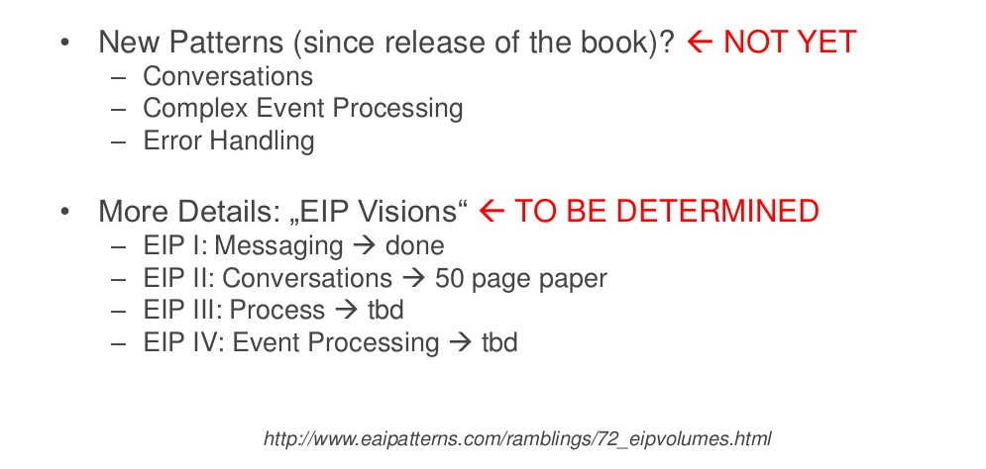
Future of EIPs: The BAD News

Slide 47
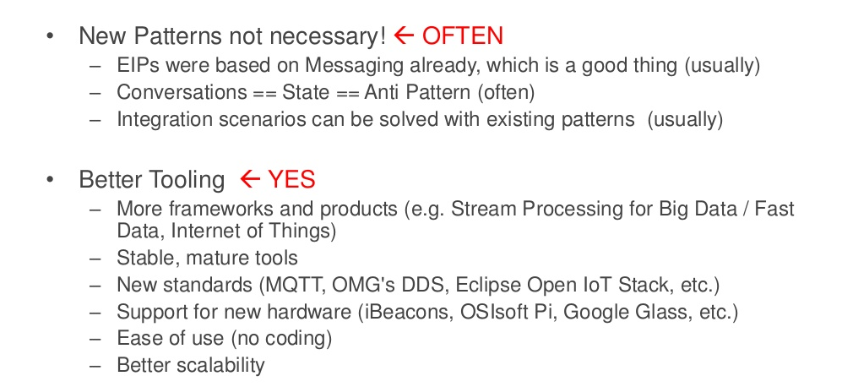
Future of EIPs: The Good News

Slide 48
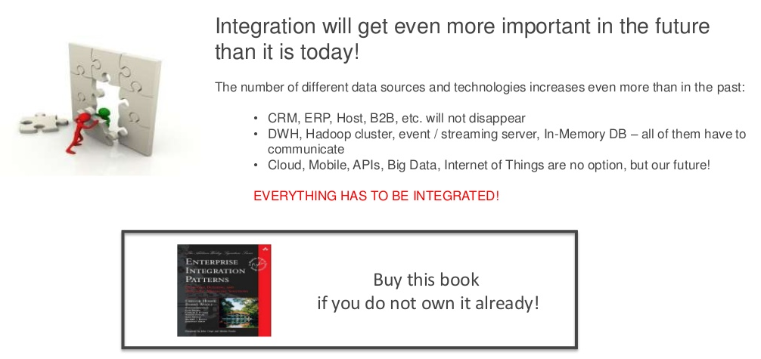
Future of Integration and EIPs

Slide 49
References
Enterprise Integration Patterns Revisited (EIP) for the Era of Big Data, Internet of Things (IoT) and Cloud – Presentation by Kai Wahner at OOP 2015 conference

Slide 50
Thank You!

